Slide 1
PrintNet T Triple Suite
Introduction
Introduction – PrintNet T
April 22, 2008
Notes:
Introduction presentation for PrintNet T

Slide 2
Agenda
GMC
PrintNet T
Introduction – PrintNet T
April 22, 2008

Slide 3
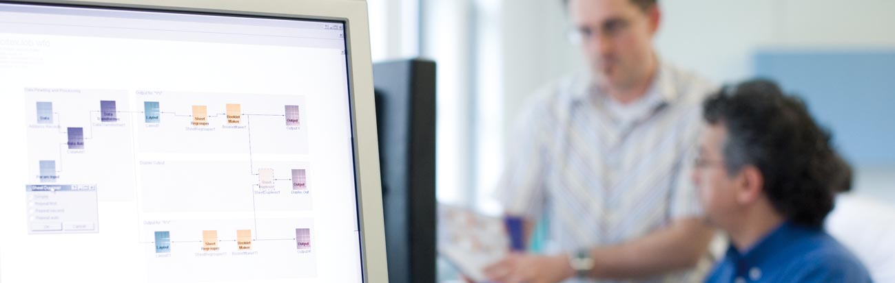
1. GMC
Introduction – PrintNet T
April 22, 2008

Slide 4
GMC
1.1 About us
1.2 What do we do?
1.3 Our partners
1.4 Our applications and markets
Introduction – PrintNet T
April 22, 2008

Slide 5
1.1 About Us
Leading Supplier of Document Composition and Production Solutions
  Founded in 1986
  Head office in Switzerland
  Development in the Czech Republic
  Local offices in Europe, Asia, and the Americas
  ~250 employees worldwide
  ~6500 installations in over 30 countries around the world
Introduction – PrintNet T
April 22, 2008

Slide 6
1.2 What Do We Do?
  Company started as a hardware and software integrator.
  Has concentrated on software development since 1994.
Major products:
  PrintNet T Triple Suite
  PrintNet WebCenter
  PrintNet PA
  PrintNet Connect / Interactive
  Conversion tools
Introduction – PrintNet T
April 22, 2008

Slide 7
1.3 Our Partners
All major printer manufacturers:
  HP
  Heidelberg
  IBM
  Kodak (Versamark, Nexpress)‏
  Miyakoshi
  Nipson
  Océ
  Xeikon
  Xerox
  Espire Infolabs
Introduction – PrintNet T
April 22, 2008

Slide 8
1.3 Our Partners
Controller Manufacturers
  EFI
  Creo
Software developers
  Adobe
  First Logic, ABA
  Interwoven (DAM Solutions)‏
Introduction – PrintNet T
April 22, 2008

Slide 9
1.4 Our Applications and Markets
Applications
  Direct mail
  Billing
  Statements
  Invoicing
  Correspondence (B2C)‏
  Booklets
Market Sectors
  Mailers/Printers
  Banks/Brokerages
  Insurance
  Utilities (electric, gas)‏
  Telecom
Introduction – PrintNet T
April 22, 2008

Slide 10
2. PrintNet T
Introduction – PrintNet T
April 22, 2008

Slide 11
PrintNet T
2.1 What is it?
2.2 Why choose it?
2.3 What does it mean for you?
Introduction – PrintNet T
April 22, 2008

Slide 12
2.1 What Is It?
PrintNet T is a second-generation document composition solution with limitless possibilities.
Single environment, all-in-one tool.
  True GUI interface capabilities to empower non-technical users
  Visual job flow
  Scripting possibility for power-users
Introduction – PrintNet T
April 22, 2008

Slide 13
2.2 Why Choose It?
  Multiple data input and data output support
  Advanced data integration and document composition for a high level of personalization and customization
  Ease and speed of implementation to improve time-to-market and conversion of legacy applications
Introduction – PrintNet T
April 22, 2008

Slide 14
2.2 Why Choose It?
  Mixed operating system support including Windows, Macintosh, Unix , AS400, and OS390
  Platform and printer independence
  Automated content approval and live proofing for quality control
Introduction – PrintNet T
April 22, 2008
Notes:
The fastest platforms are: 1. Linux, 2. Windows, 3. Mac and Solaris (hasn’t been tested on speed yet, but the difference is not so big. It depends more on hardware).

Slide 15
2.3 What Does It Mean For You?
Do More. Faster. Your Way.
Introduction – PrintNet T
April 22, 2008

Slide 16

Thank You.
Do You Have Any Questions?
Introduction – PrintNet T
April 22, 2008

